Slide 1
Exercise and Fitness Metrics Analysis
By : Team 4 - Enigma

Slide 2



The Problem Identifying patterns in exercise data can help prevent injuries and improve training effectiveness | The Solution Using data science tools, we analyzed exercise and fitness metrics to uncover trends and insights. | The Result Our analysis provides valuable insights that can be used to optimize training techniques and enhance overall performance.

Slide 3

Dataset Overview
What's inside? | Structured
Explore a dataset with 3865 observations and 18 features but initially 11 | Our dataset is complete and carefully selected to ensure that you're working with the most relevant information.

Slide 4
Data Preprocessing
Conversion of Data Types from Character to Factor
Typecasted Exercise, Gender, and Weather Conditions columns
BMI categories – Healthy, Overweight and Obese. Intensity categorizes - High, medium and low intensity.
Creation of new categories for BMI, Intensity and Heart Rate

Slide 5
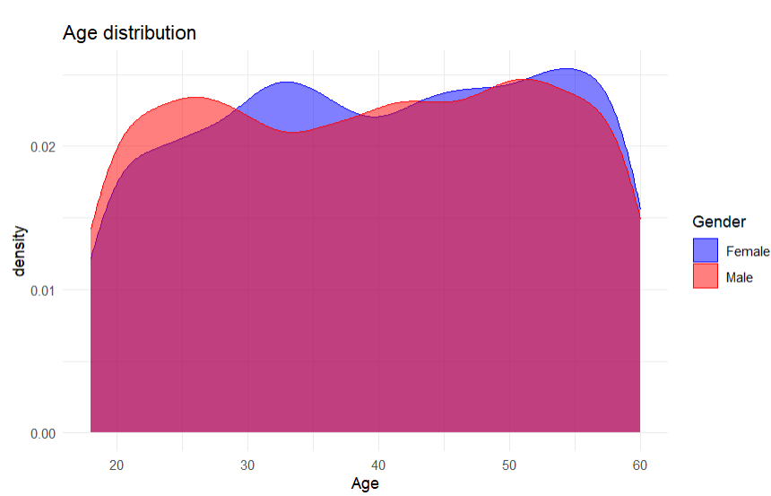
Data Visualization
Age distribution
Age analysis shows that men are more active until the age of 28, then women dominate.
In addition, there are a large number of people over the age of 60.

Slide 6
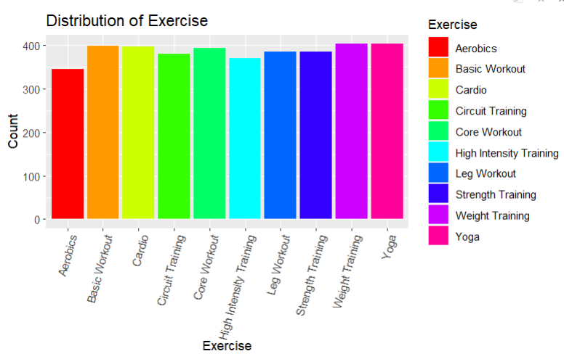
Data Visualization
Exercise distribution
Frequency: The chart reveals the frequency of each exercise type, providing insights into the most common exercises in the dataset.
Diversity: The dataset includes a wide variety of exercises, ranging from "Weight Training" to "Yoga," with varying levels of participation.
This chart serves as a foundational step for exploring the dataset's exercise composition, guiding further data analysis.

Slide 7
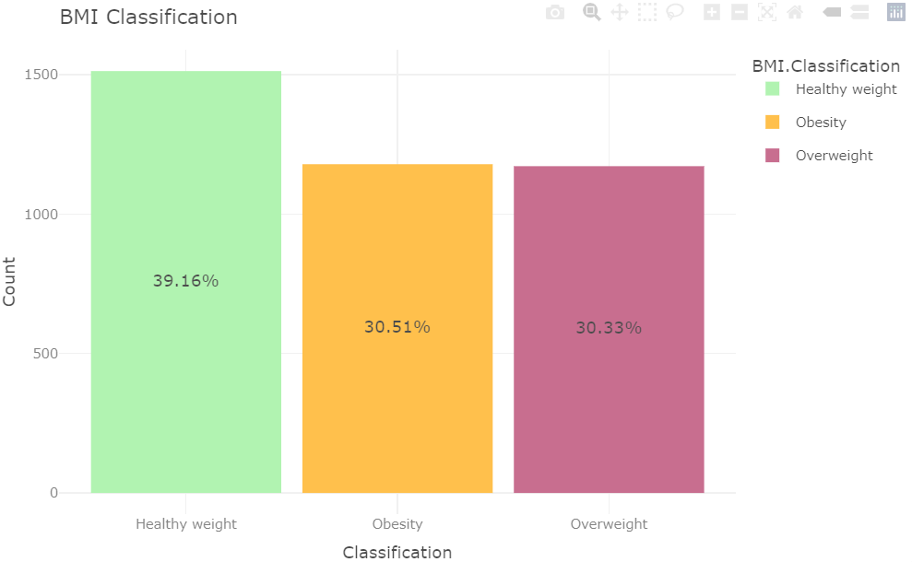
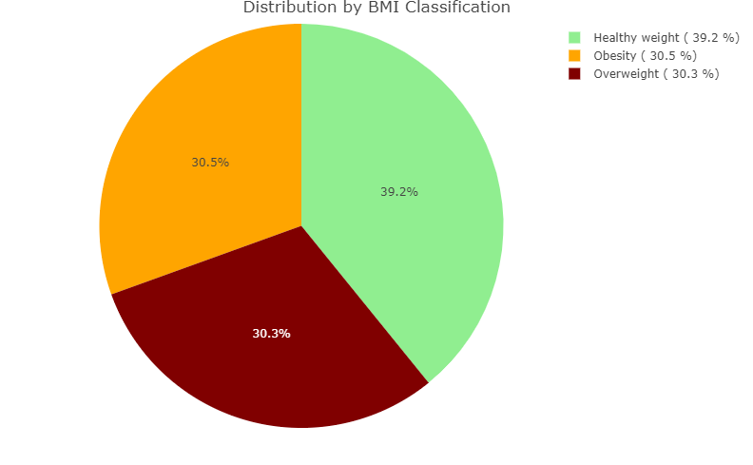
Data Visualization
BMI Classification and Distribution
“Healthy weight” is the most prevalent category, while "Obesity" is also noticeable in the dataset.
The pie chart complements the bar chart, providing a quick and intuitive overview of the dataset's BMI composition.

Slide 8
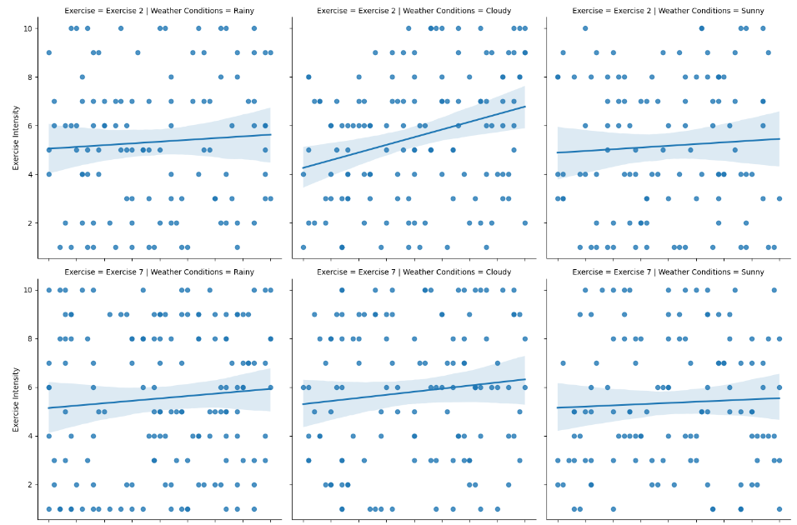
Data Visualization
Weather & Exercise
A grid of scatter plots to explore the relationship between exercise duration and intensity for diverse exercise types and weather conditions.
Line of Best Fit: Improves trend visualization and comprehension through the inclusion of trend lines, simplifying trend analysis.

Slide 9

SMART Questions
How do age, weight, and duration collectively influence the relationship between exercise intensity and calorie burn?

Slide 10
Solution
Age and duration positively affect exercise intensity, while actual weight has a negative impact.
The model explains 85.15% of exercise intensity variance.
Collectively, these factors significantly shape exercise intensity.

Slide 11
SMART Questions
2. Can we establish a time-based trend in the dataset, such as changes in exercise preferences, calorie expenditure, or weight measurements over time?

Slide 12
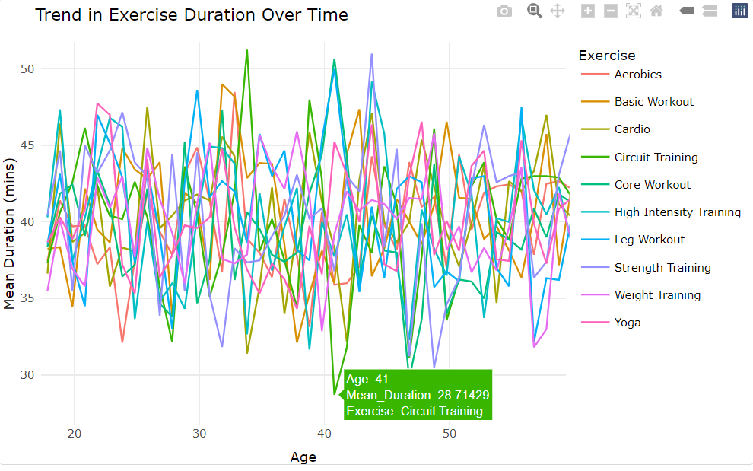
Solution
Age Impacts Exercise Duration: Exercise preferences change with age, influencing the duration of workouts.
Tailored Fitness Programs: Recognizing these trends allows for tailored fitness programs based on age groups.
Promoting Sustainable Habits: Understanding age-related changes promotes healthier, sustainable exercise habits.

Slide 13
SMART Questions
3. Do males and females exhibit different patterns in terms of exercise variety?

Slide 14
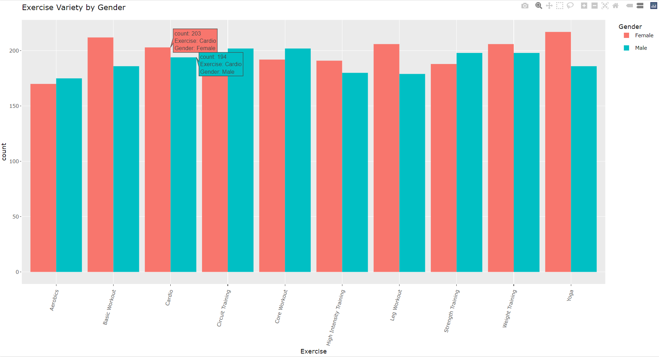
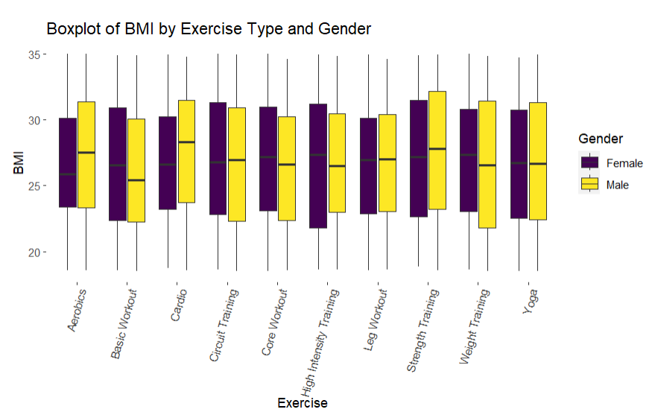
Solution
Gender-Specific Preferences: The plot highlights gender-specific exercise preferences.
Consistent Trends: Similar exercise choices suggest consistency between males and females.
This analysis aids in understanding gender-related differences in exercise variety patterns and identifies any exercise types that are particularly popular among one gender.

Slide 15
SMART Questions
4. Which exercises are more popular in the different weather conditions?

Slide 16
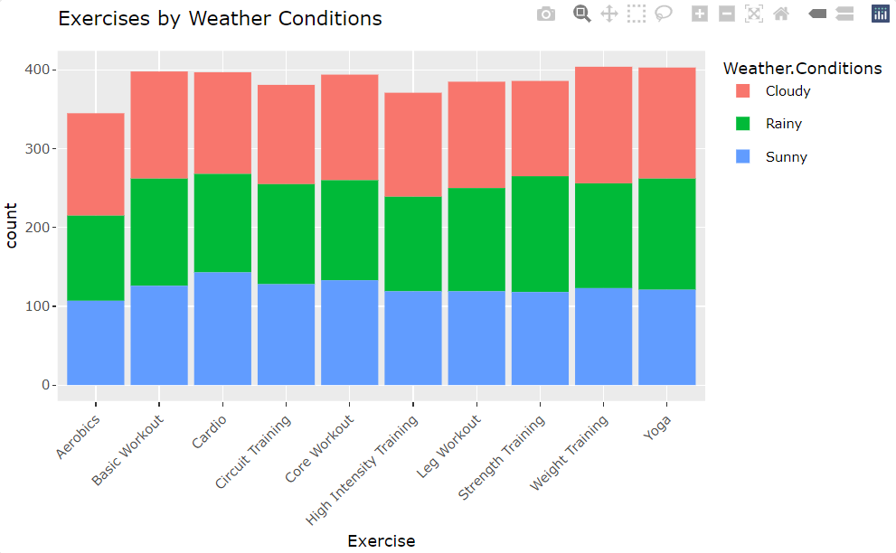
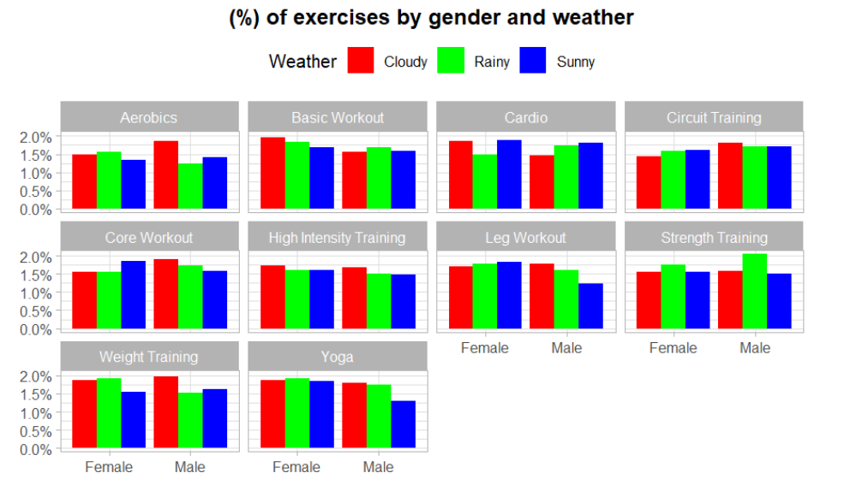
Solution
Exercise Preferences by Weather: The code generates a bar plot showcasing exercise preferences under various weather conditions.
Analyzing Exercise Trends: We can analyze the plot to identify trends and patterns, providing insights into whether indoor or outdoor exercises are favored based on the weather.
Weather-Influenced Exercise Choices: The data helps us understand how weather conditions influence exercise choices, potentially leading to more tailored workout recommendations.

Slide 17
SMART Questions
5. Exercise Preference Across Different Durations and Frequency?

Slide 18
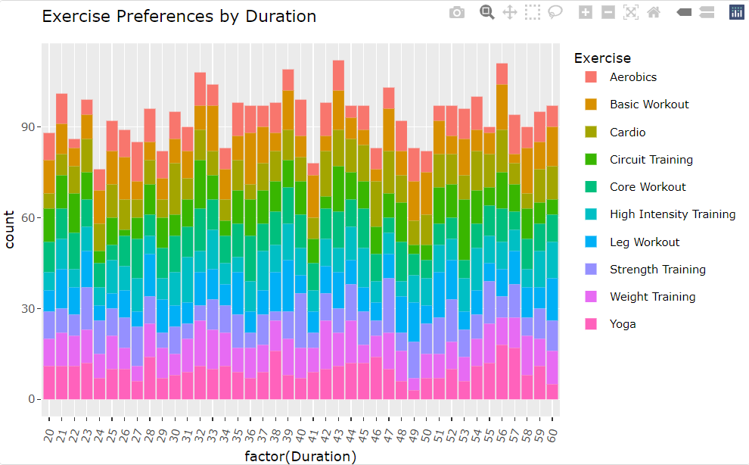
Solution
Time-Exercise Matching: The data shows that people tend to align exercise types with available workout durations.
Adaptable Fitness Choices: The values reflect individuals' adaptability in their fitness preferences based on time constraints.
Personalized Fitness Planning: These insights underscore the need for personalized fitness plans that optimize exercise duration for weight management and fitness goals.

Slide 19
Statistical Test
Q: Is there a significant difference in the 'Calories Burn' across different 'BMI Classification' groups?
A: A suitable test for this question would be Analysis of Variance (ANOVA), particularly since we have more than two BMI Categories in our dataset (e.g., Healthy, Overweight, Obese).

Slide 20
One –Way ANOVA test
Question :
Hypothesis :
H0: The mean 'Calories Burn' is the same for all 'BMI Classification' groups.
H1: At least one 'BMI Classification' group has a different mean 'Calories Burn'
Is there a significant difference in the 'Calories Burn' across different 'BMI Classification' groups?

Slide 21

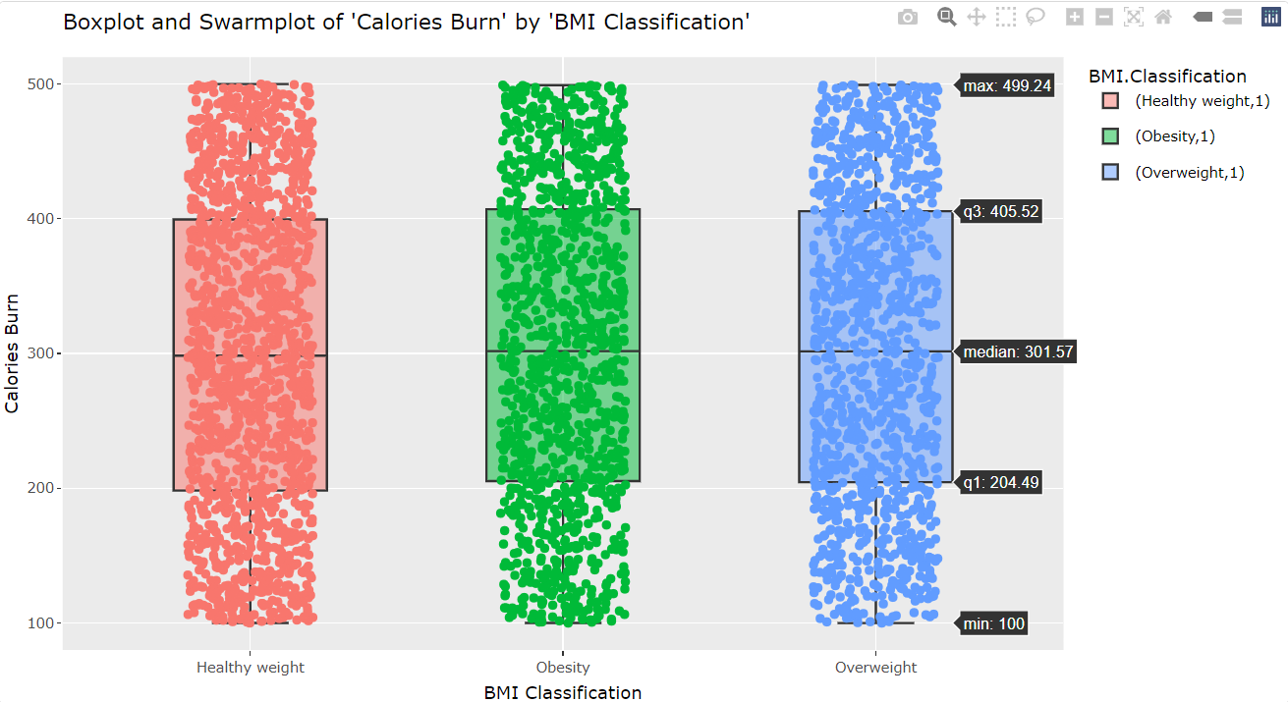
Model Output
The swarm plot overlay on the boxplot displays individual data points, sampled to avoid clutter.
This provides a sense of the data distribution while still summarizing it with a boxplot.
Once more, the distribution of points appears quite similar across the 'BMI Classification' groups.

Slide 22
Interpretation
Conducted a One-Way ANOVA to assess whether there are significant differences in "Calories Burned" among different "BMI Classification" categories (Healthy Weight, Overweight, Obesity).
Result : It indicated that there was no statistically significant difference in "Calories Burned" among the BMI groups (F-value = 0.676, p-value = 0.509).
This suggests that the means of "Calories Burned" were not significantly different across BMI classifications.

Slide 23
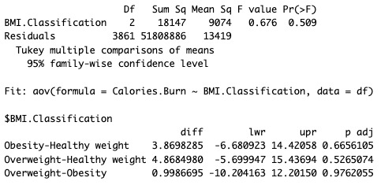
Post–Hoc Test
Further Analysis :
Result :
Test confirmed the ANOVA results.
Comparisons between the "BMI Classification" groups showed that there were no significant differences in "Calories Burned" between any of the groups (p-values > 0.05).
Performed a Tukey HSD test for post-hoc analysis to further explore group differences.

Slide 24
Conclusion
The hypothesis was tested through the ANOVA and Tukey HSD analysis, which examined whether "Calories Burned" varies significantly among individuals with different BMI classifications. Based on the results:
The analysis did not provide sufficient evidence to conclude that there are statistically significant differences in "Calories Burned" among individuals with different BMI classifications.
Therefore, we do not have enough evidence to support an alternative hypothesis, and the null hypothesis stands.

Slide 25
THANK YOU Aniruddha Vishnu Yash

